Slide 1
FROM COLLABORATION TO CHANGE:
Engaging with Community Schools

Slide 2
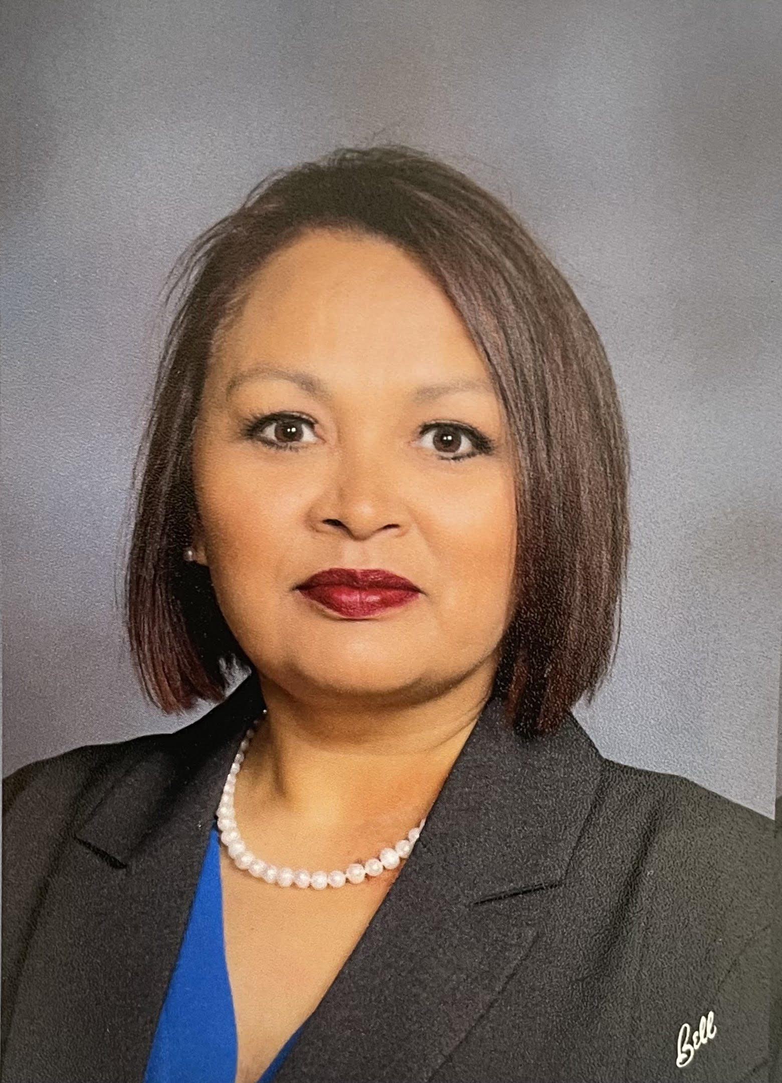
WELCOME!
Jamie Garza
American Falls School District
Programs Director
Notes:
Programs I am over: Early Learning Collaborative, Dual Language Immersion, English Language Learners, Migrant Education Program, Community Schools

Slide 3
WELCOME!
Katie Marshall
Engagement and Sustainability Manager
United Way of Treasure Valley-
Idaho Coalition for Community Schools

Slide 4
AGENDA
Community School Strategy 101
Partnerships in American Falls School District
Mapping Partnerships: What Can YOU Do?
Practical Strategies for Sustainable Partnerships
Q&A and Closing Discussion

Slide 6
Community Schools are neighborhood public schools that partner with their local communities to foster environments where every student can thrive.

Slide 7
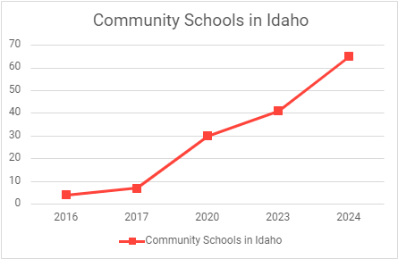

Slide 8
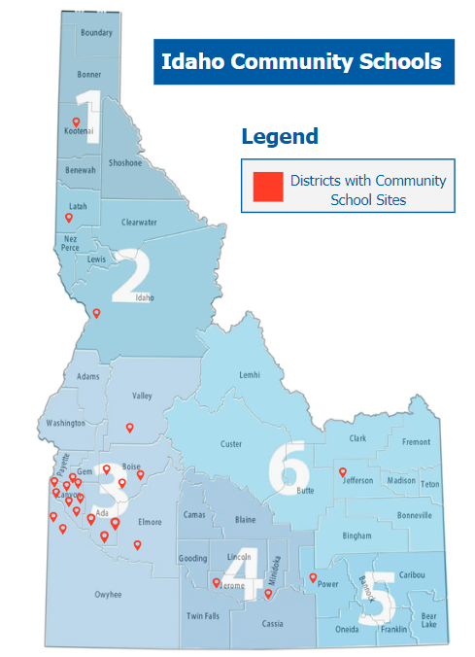

Slide 9
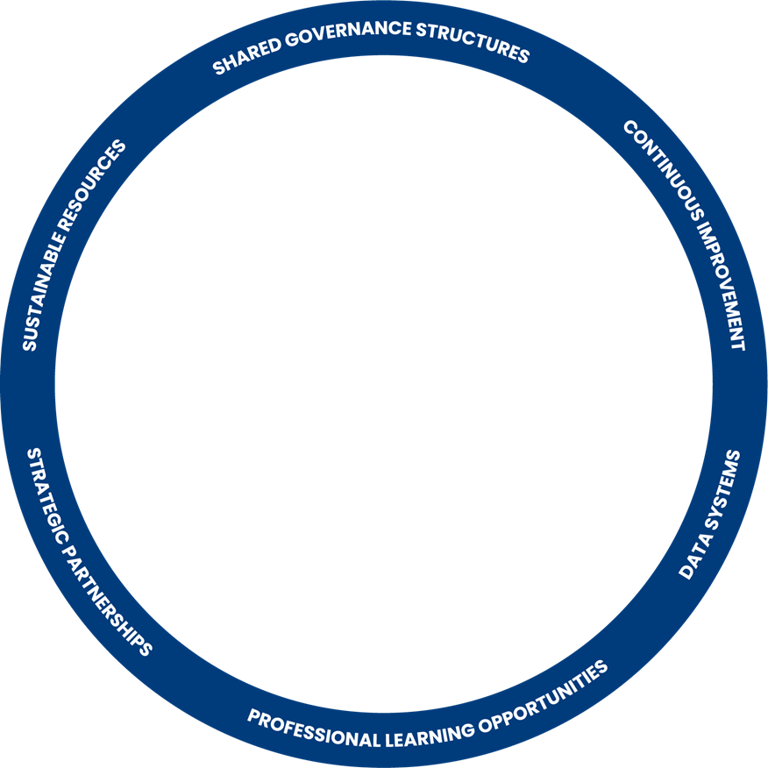
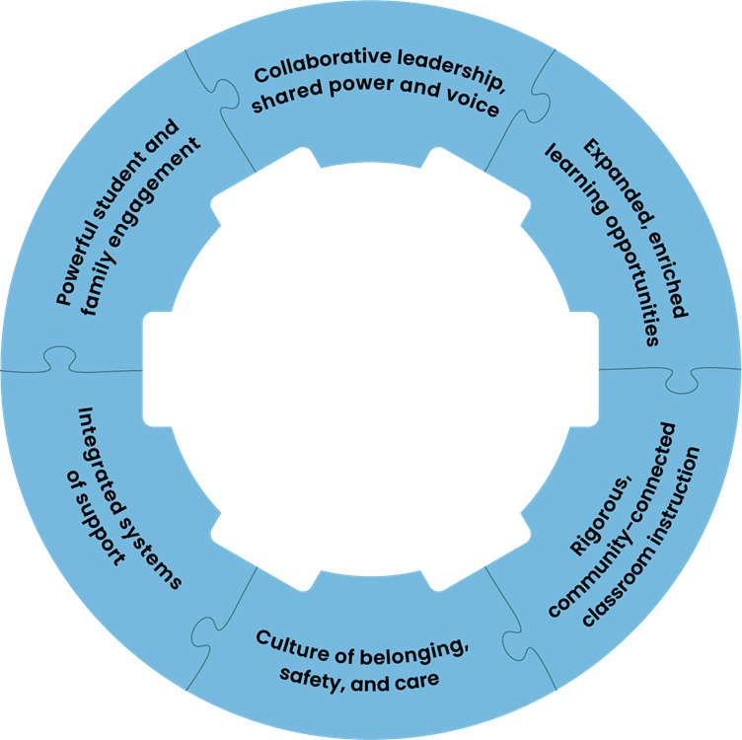
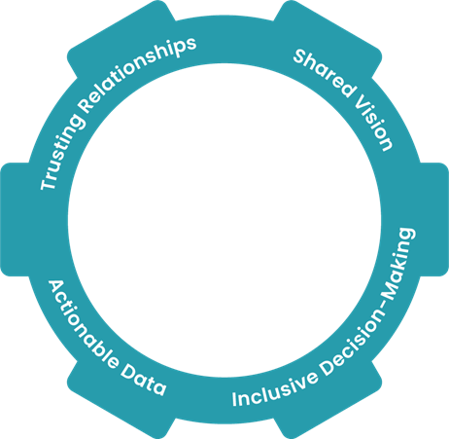
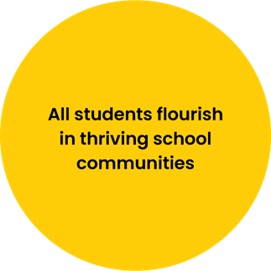

Slide 10
KEY ELEMENTS
Full Time Community School Coordinator
The point person at a school- your contact for partnerships
A leader in the building or district, working with the principal to implement CS Strategy
Advisory Council
Broad representation: community members, businesses, nonprofits, students, parents etc.
Needs and Assets Assessment
Guide the programs, services, and activities of each individual school

Slide 11
PARTNERSHIPS IN AMERICAN FALLS

Slide 12
Mapping Partnerships:
How can you and your community collaborate to support kids and families?

Slide 13
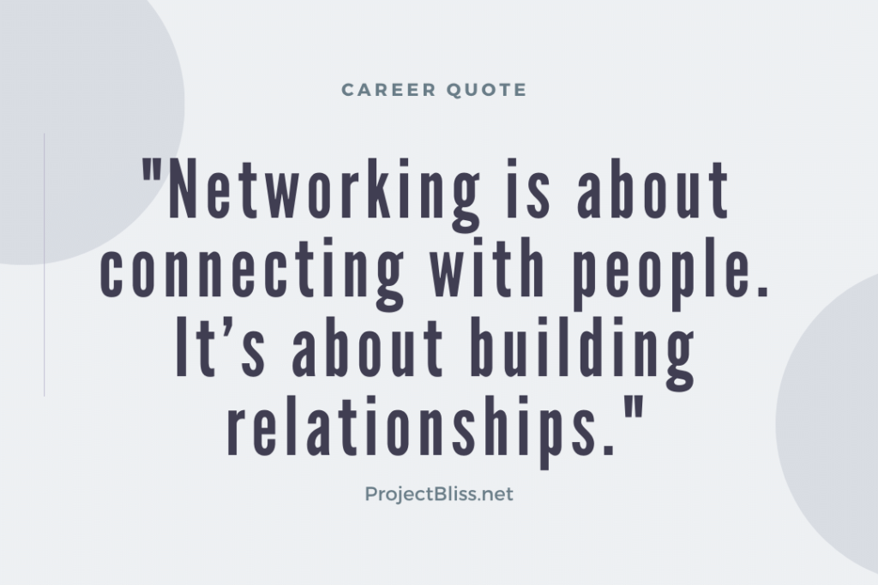
PRACTICAL STRATEGIES
“Know Me Before You Need Me”
Bring together your stakeholders
Schedule regular check ins
Host listening sessions
Utilize Social Media
Offer & Accept Help Generously
Follow up

Slide 14
SUSTAINING PARTNERSHIPS
Identifying
Who is already doing similar work in the area? Whose mission aligns with yours?
Communicating Value
What mutual benefits exist?
Formal and Informal Agreements
What must be in place for the work to move forward?

Slide 15
Questions?
Ideas?

Slide 16
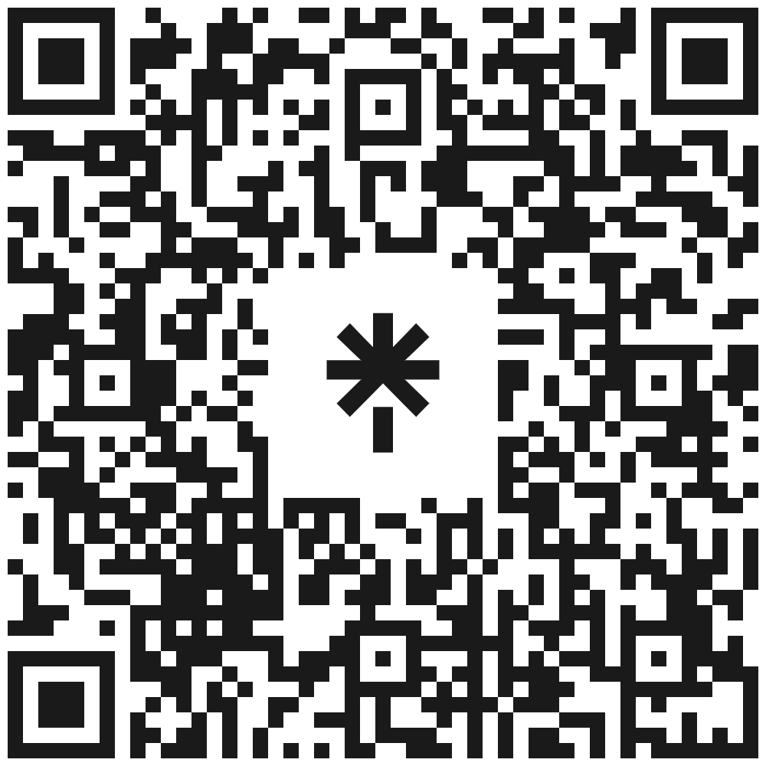
STAY IN TOUCH
Scan For:
Monthly Newsletters
Check out an American Falls story in our February Newsletter!
Upcoming Webinars
Social Media
Website

