Slide 1
Reaching the
Building a Campaign to End Child Sexual Abuse in Idaho

Slide 2
Presenters
Heather Kemp, Bannock Youth Foundation, Pocatello
Norma Pintar, VISTA at Idaho Children’s Trust Fund, Boise
Roger Sherman, Idaho Children’s Trust Fund/Prevent Child Abuse Idaho
Katie Simmons, ICARE program, St. Vincent DePaul, Coeur d’Alene

Slide 3
Workshop Goals
To make you aware of the resources that exist to prevent child sexual abuse
To make you aware of how we are currently using them
To reach a shared understanding of why reaching the tipping point matters
To enlist your help in figuring out how to reach 57,000 adults in Idaho

Slide 4
Stewards of Children® Trailer
This video provides a quick overview of D2L's award-winning Stewards of Children child sexual abuse prevention training program.
https://www.youtube.com/watch?v=vW4_8-tmr7g&feature=youtu.be

Slide 5
Small actions at the right time, in the right place, and with the right people can create a "tipping point" for anything from a product to an idea to a trend.
The "tipping point" is "that magic moment when an idea, trend, or social behavior crosses a threshold, tips, and spreads like wildfire."

Slide 6
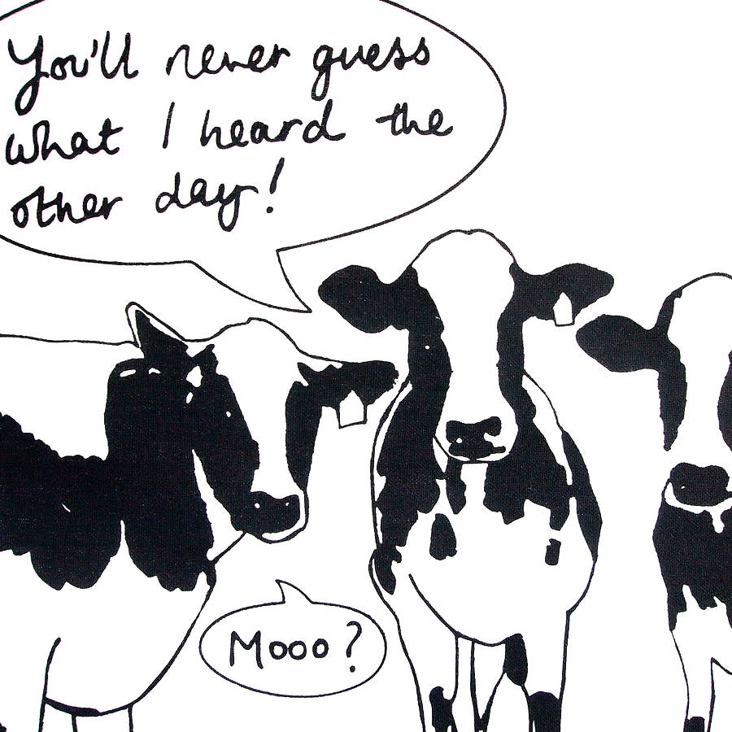
Law of the Few
Mavens are individuals who spread influence by sharing their knowledge with friends and family.
Connectors know a lot of people. They gain their influence not through expertise, but by their position as highly connected to various social networks.
Salesmen are individuals who naturally possess the power of persuasion.

Slide 7
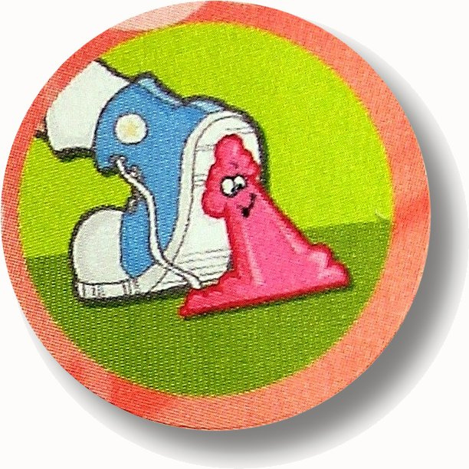
The Stickiness Factor
The stickiness factor is a unique quality that causes the phenomenon to "stick" in the minds of the public and influence their behavior.

Slide 8
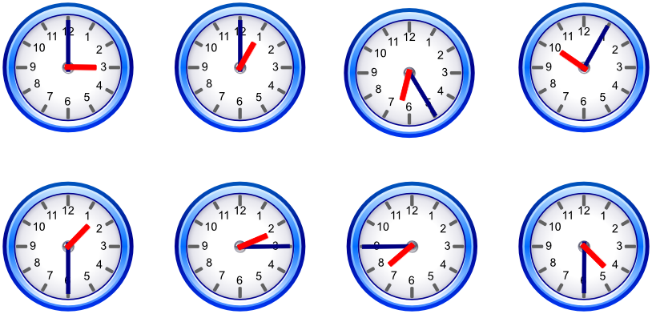
The Power of Context
The Power of Context refers to the environment or historical moment in which the trend is introduced. If the context is not right, it is not likely that the tipping point will take place.

Slide 9
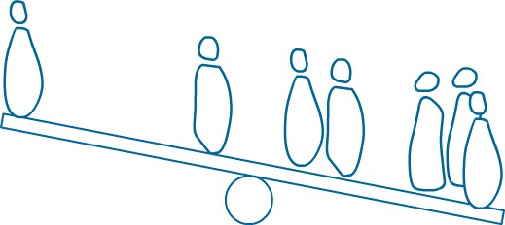
How does this apply?
Our plan is to reach 5% of the adults in Idaho or 57,000 people to be Stewards of Children
These 57,000 will protect 10 children each or 570,000 kids. Wow!
We need to be both opportunistic and strategic to reach all the people in all the right places

Slide 10
Stewards Resources
Over 100 facilitators statewide to do face to face training
3 training coordinators around the state
Free online training through December 2015
Materials: workbooks, new videos
3 instructors to train facilitators
Relationships

Slide 11
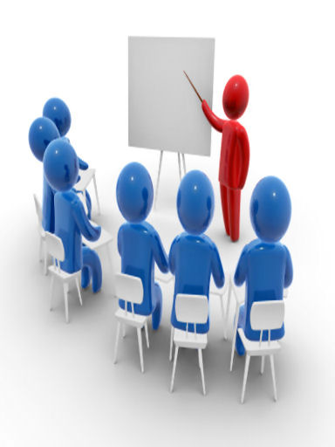
What have we done so far?
Over 6000 people have been trained so far in Idaho
Treasure Valley Initiative
North Idaho efforts
Eastern Idaho efforts
Some funding, lots of partners

Slide 12
Outreach Brainstorm

Slide 13
Small Group Discussion

